Slide 1
Human Activity recognition With smartphone
Project Team
Group Number: 03
Group Members:-
1. Teena Thakre
2. Ankush Kuchankar
3. Viraj Khamankar

Slide 2
CONTENTS
Introduction
Problem Definition
Scope of Project
Technology used
Architecture Diagram
Functional Requirement
Advantages
Challenges
Applications
Conclusion

Slide 3
INTRODUCTION
In this project, we aim to develop a system that can automatically recognize and classify human activities based on sensor data from smartphones.
The project leverages the Human Activity Recognition (HAR) database, which records activities of daily living (ADL) using a waist-mounted smartphone with embedded inertial sensors.
The goal of this project is to make a model on Smartphone that can easily recognize the human activity. Moreover active learning models are developed in order to reduce labeling time and burden. Through testing and comparing with different learning algorithms, we find one best fit model for our system.

Slide 4
PROBLEM DEFINITION
How can we use smartphone sensor data to make computers correctly recognize human activities like walking, sitting, and more?
The problem being addressed is the classification of human activities based on sensor data.
Challenges include handling noisy sensor data, distinguishing between different activities, and achieving high accuracy in classification.

Slide 5
SCOPE OF PROJECT
The scope of this project covers the following aspects:
Use of the Human Activity Recognition database for data collection.
Recognition of six activities: WALKING, WALKING_UPSTAIRS, WALKING_DOWNSTAIRS, SITTING, STANDING, LAYING.
Data preprocessing, including noise filtering, feature extraction, and dimensionality reduction.
Utilization of machine learning models to classify activities.
Model evaluation and testing.

Slide 6
TECHNOLOGIES USED
PROGRAMMING LANGUAGE : PYTHON
TOOLS: JUPYTER NOTEBOOK

Slide 7
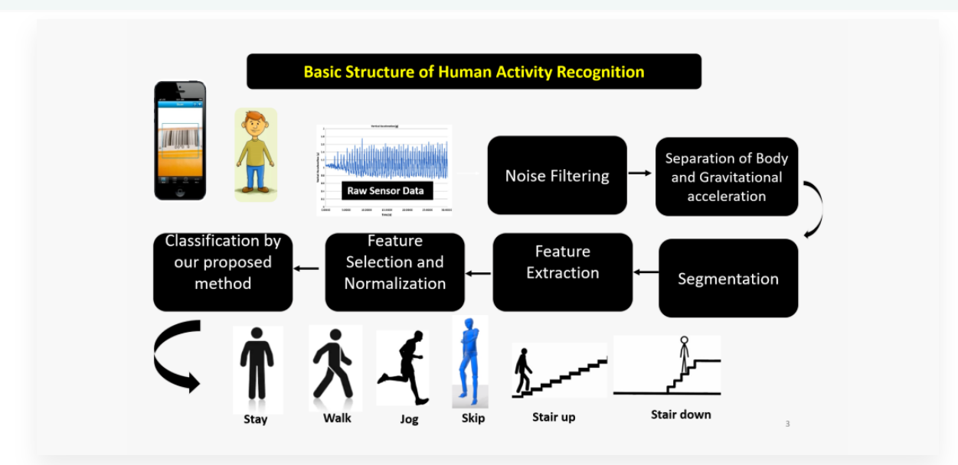
ARCHITECTURE DIAGRAM

Slide 8
FUNCTIONAL REQUIREMENTS
Functional requirements of the project include:
Data loading and exploration.
Data preprocessing, which includes handling missing values and duplicated columns.
Feature engineering techniques such as dimensionality reduction (SelectKBest and RFE).
Model selection (Logistic Regression , Decision Tree, Random Forest, KNN, SVM and Gradient Boosting) and training.
Model evaluation using metrics like accuracy.
Optional: Model deployment or real-time activity prediction.
User interface for opening and processing CSV files (implemented using tkinter).

Slide 9
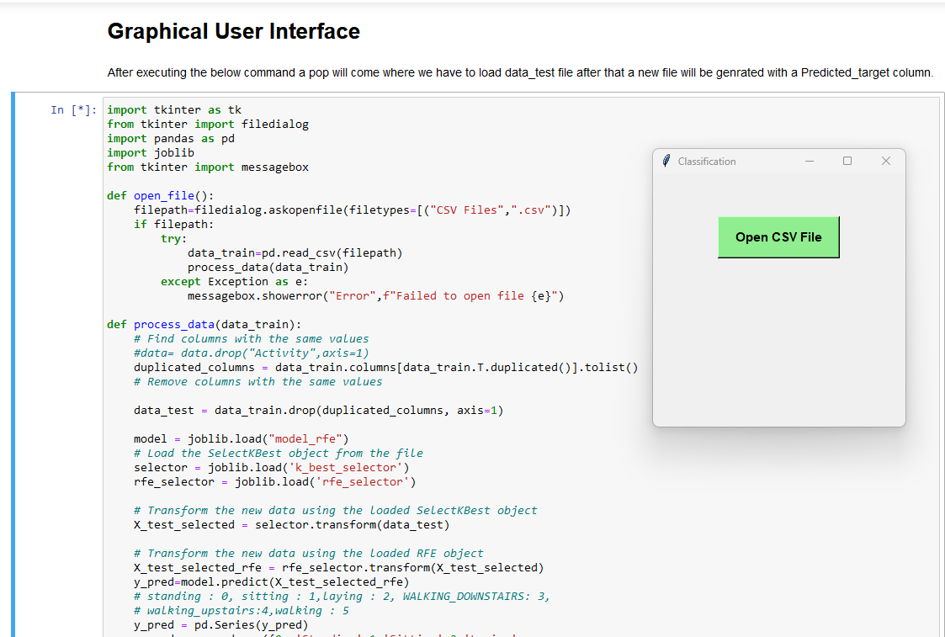
Screenshots of Result
1. After executing the GUI code a pop will get generated:

Slide 10
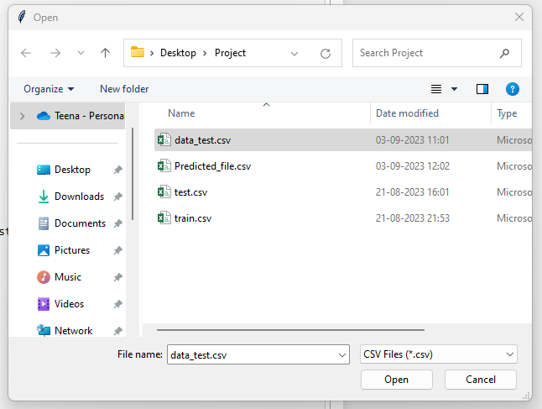
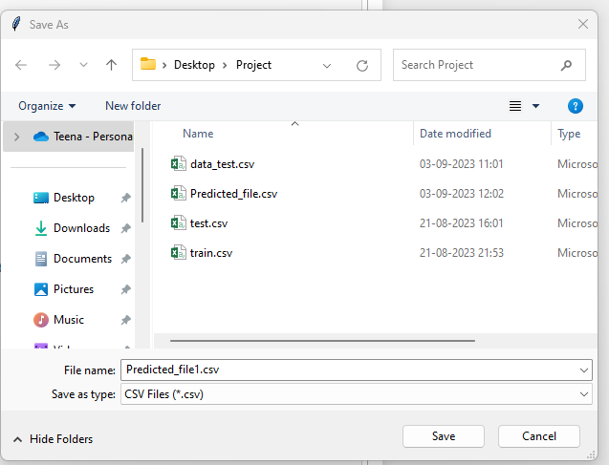
2. In that Open CSV file we have to load data_test.csv file for Predictions:
3. After opening the data_test.csv file we have to save a new file to get the Predicted_target column.

Slide 11
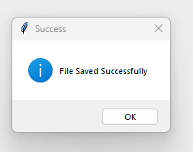
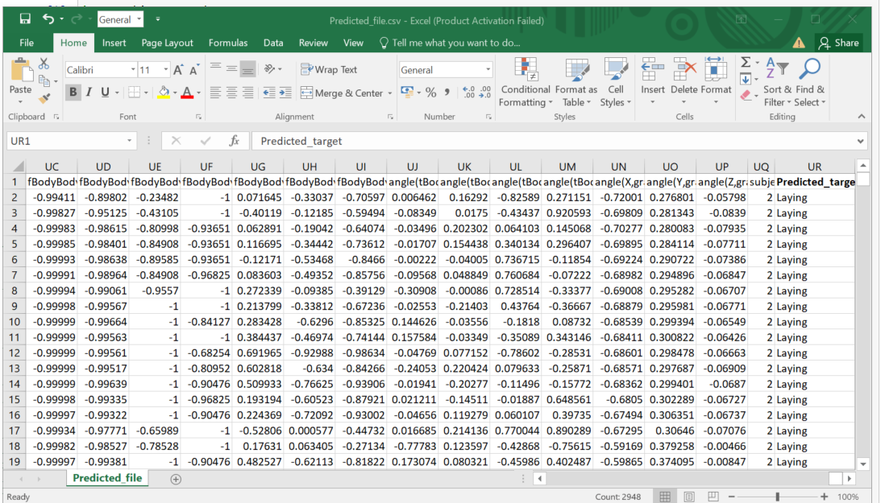
4. The new file will get saved sucessfully:
5 .The final Predicted_file is:

Slide 12
ADVANTAGES OF HUMAN ACTIVITY RECOGNITION
Portability
Multi-Sensor Integration
Rich Data Types
Cost-Effectiveness
Real-time Monitoring
Real-world Applications
Privacy Considerations
User Engagement

Slide 13
CHALLENGES IN HUMAN ACTIVITY RECOGNITION WITH SMARTPHONE
Noisy Data
Data Variability
Limited Sensor Placement
Data Imbalance
Model Complexity
Data Labeling
Real-time Processing
Privacy and Ethics
Model Deployment
Interactivity
Overfitting

Slide 14
APPLICATION OF HUMAN ACTIVITY RECOGNITION WITH SMARTPHONE
Fitness and Wellness Tracking
Healthcare Monitoring
Sports Performance Analysis
Gesture Recognition
Context-Aware Applications
Security and Authentication
Disease Monitoring and Management

Slide 15
CONCLUSION
Human activity recognition (HAR) using smartphones is a versatile technology with widespread applications.
Smartphones' portability, sensors, and algorithms allow us to track fitness, monitor health, analyze sports, enable gesture control, adapt to contexts, enhance security, and manage diseases.
Despite challenges like data quality and privacy, smartphone-based HAR continues to advance, promising a future where technology enhances our understanding of human behavior and enriches various aspects of our lives.

